Slide 1
Strategies for SELf-regulation
6th July 2022
Will Turnpenny
Magdalen Gates Primary School

Slide 2
What is regulation?
Emotional self-regulation is the ability to respond to the ongoing demands of experience with the range of emotions in a manner that is socially tolerable and sufficiently flexible to permit spontaneous reactions as well as the ability to delay spontaneous reactions as needed.

Slide 3
What is regulation?
Emotional self-regulation is the ability to respond to the ongoing demands of experience with the range of emotions in a manner that is socially tolerable and sufficiently flexible to permit spontaneous reactions as well as the ability to delay spontaneous reactions as needed.

Slide 4
What are the zones of regulation?

Slide 5
What are the zones of regulation?
in control

Slide 6
Emotions are responses
Our experiences (both sensory and social) give us feelings.
We all experience feelings across the four zones.

Slide 7
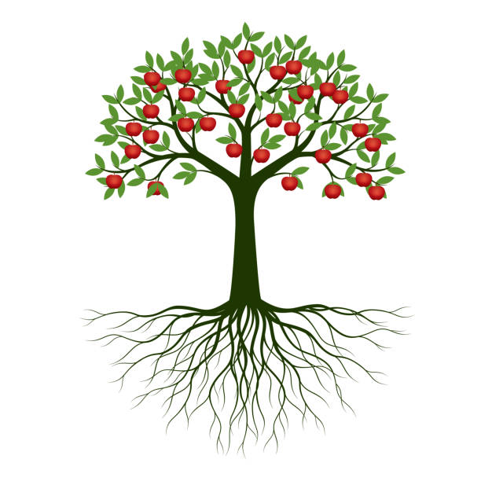
Emotions are responses
Our experiences (both sensory and social) give us feelings.
We all experience feelings across the four zones.

Slide 8
We are trees in a forest
Our feelings affect our behaviours.
Our behaviours affect other people’s feelings and behaviours.

Slide 9
It’s good to be green
Managing ourselves so that we stay in the green zone is positive:
-We are more likely to be successful.
-Our positive behaviours will give people positive feelings about us (and is more likely to lead to positive behaviour towards us).
-It feels less stressful/depressing to be in this zone.
-This zone is socially acceptable.
We have to listen to our bodies and thoughts to understand our zones.
We need to use strategies to bring us back to green.

Slide 10
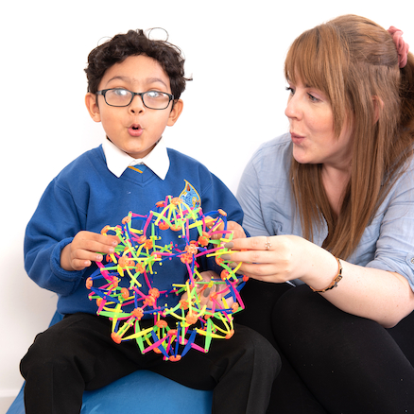
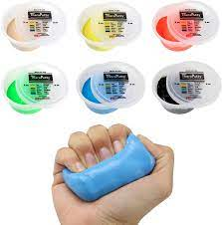
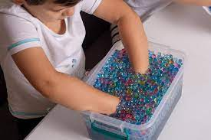
Sensory strategies and calming techniques
Our feelings have physical effects on us.
Physical strategies can affect our feelings.

Slide 11
Thinking techniques and problem solving
What size is the problem?
What would your inner coach say?
Fact or opinion?

