Slide 1
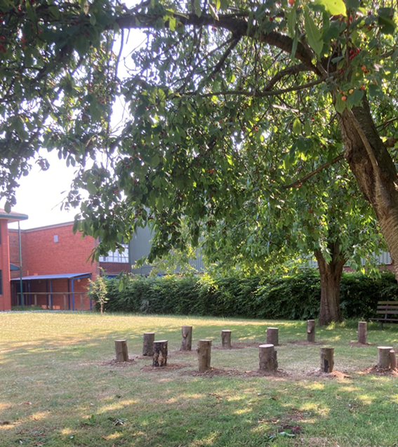
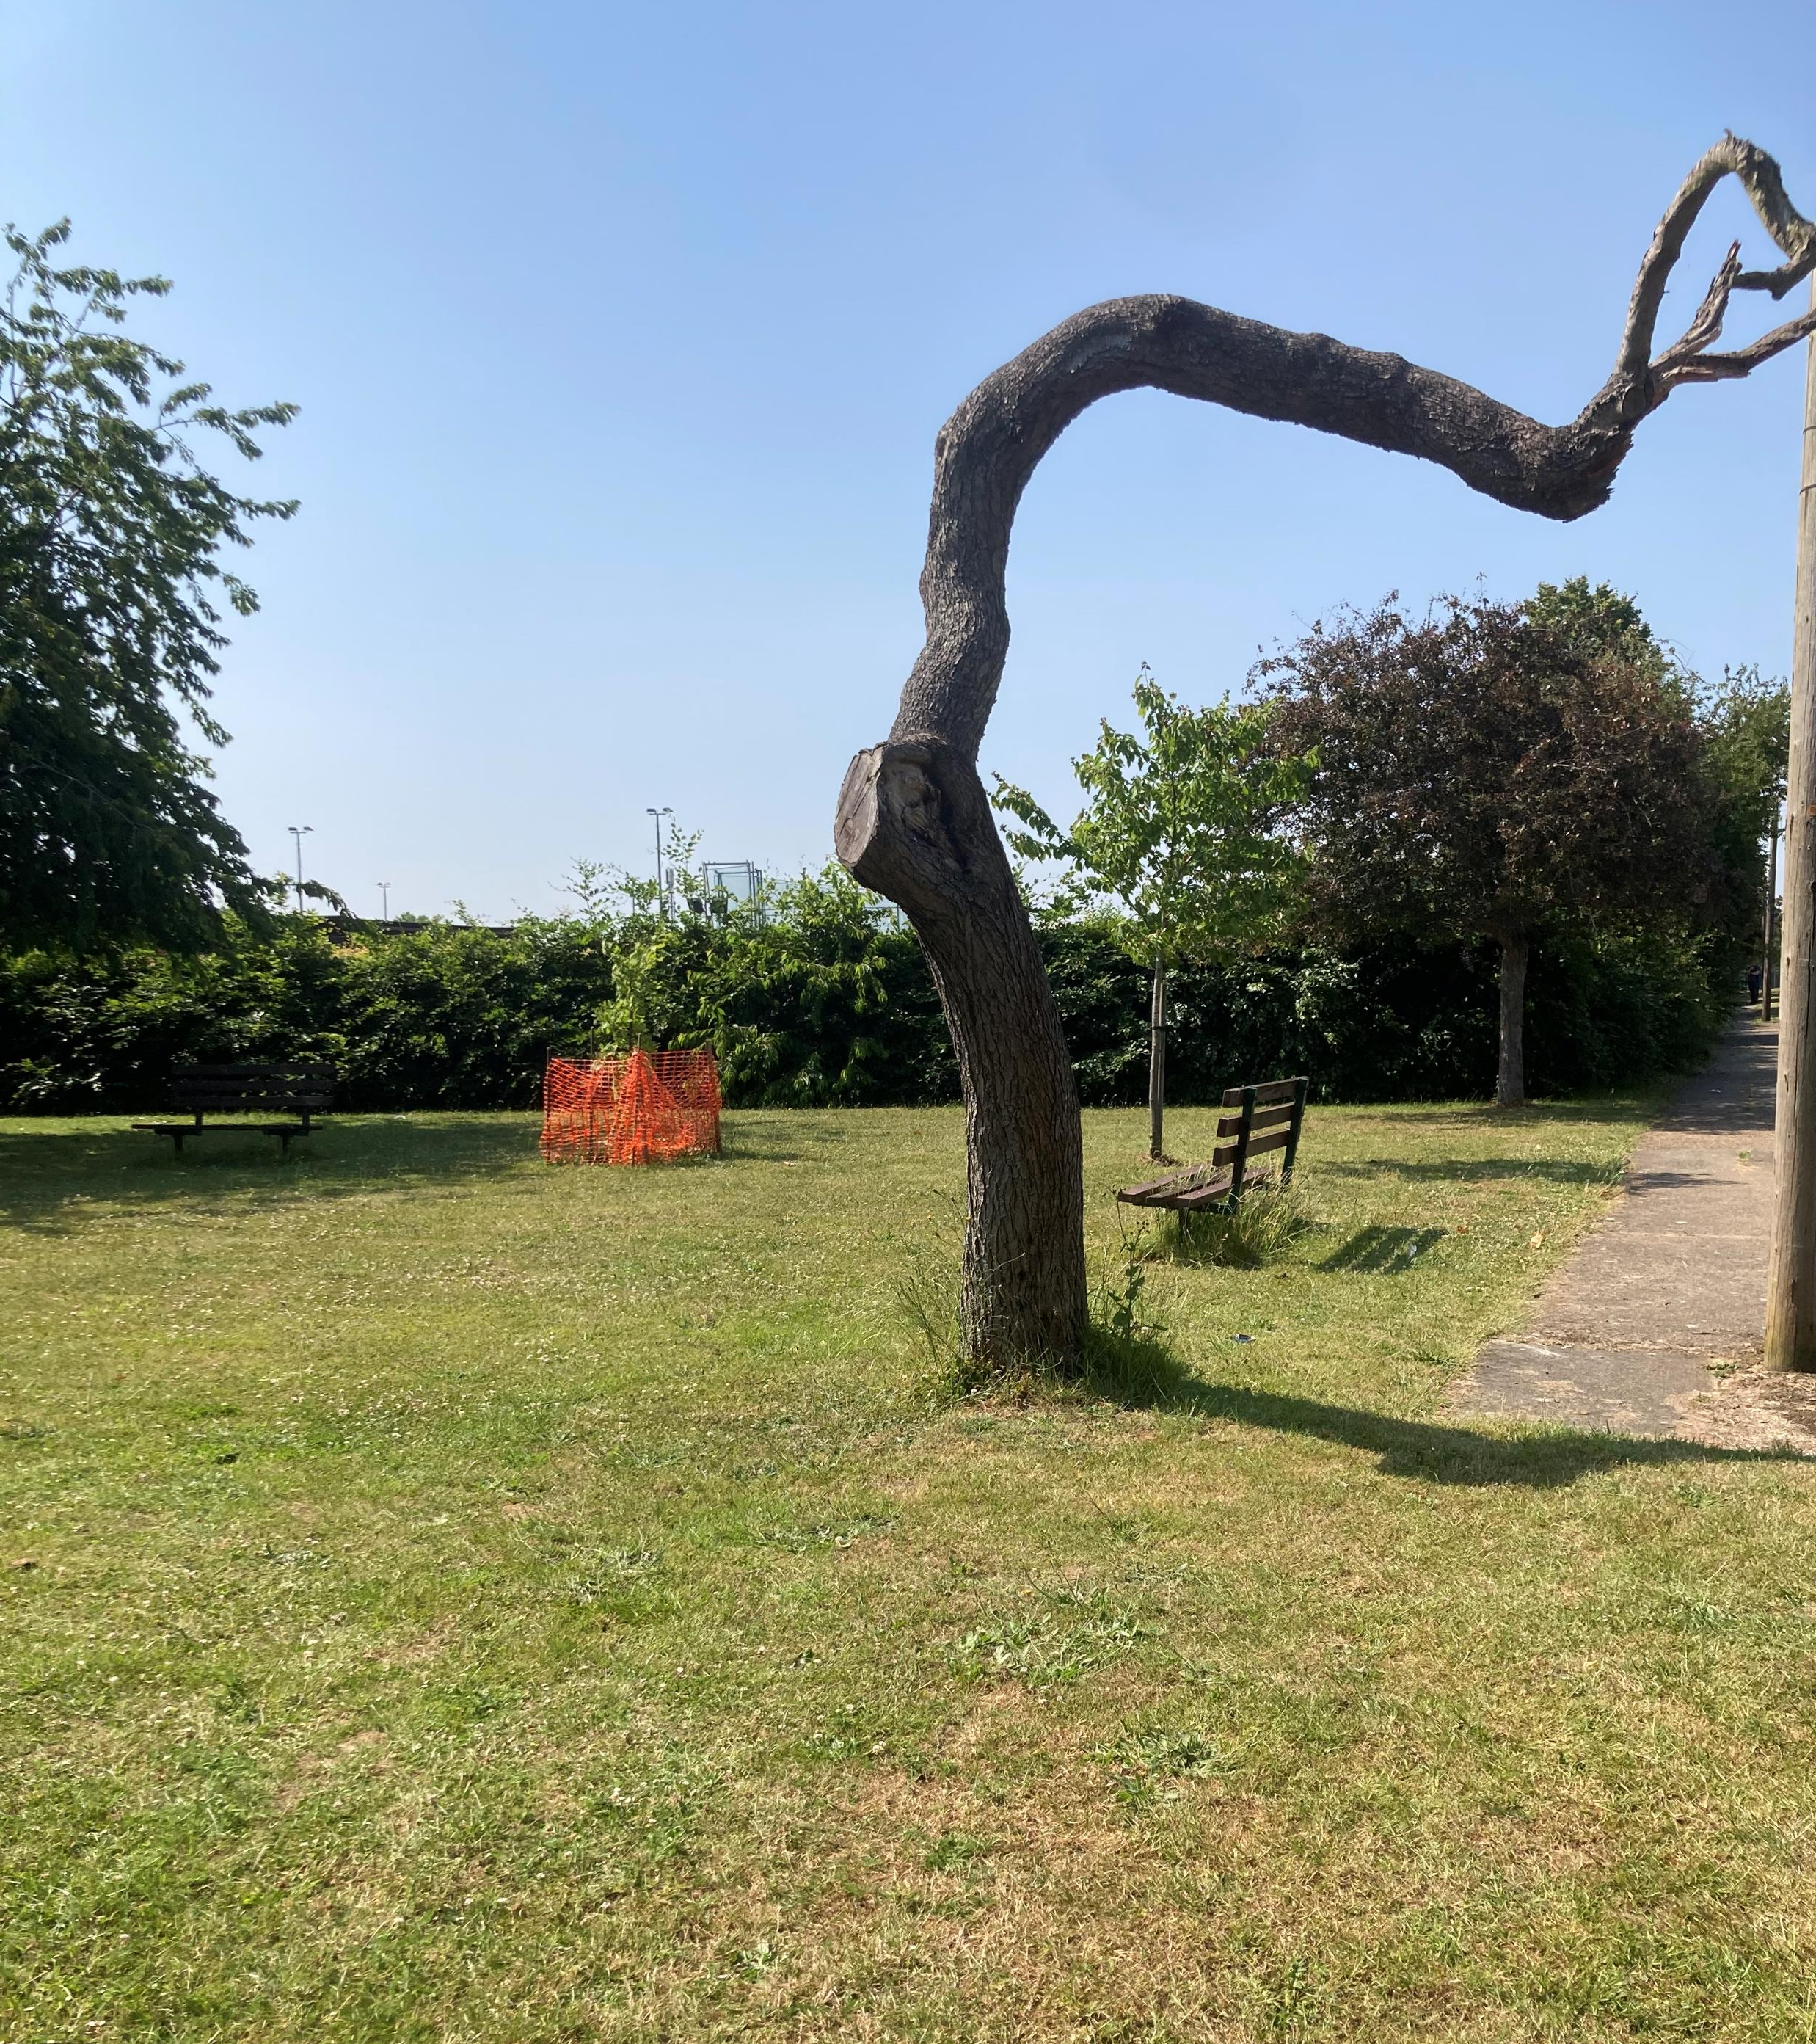
Frank Bright’s MBE Garden of Learning and Reflection
We are building a mural to be installed in Frank’s garden of learning and reflection for us all
to learn from the past
be inspired to make a difference now, and in the future
to share stories
to celebrate our diverse community
Our story telling circle

