Slide 10
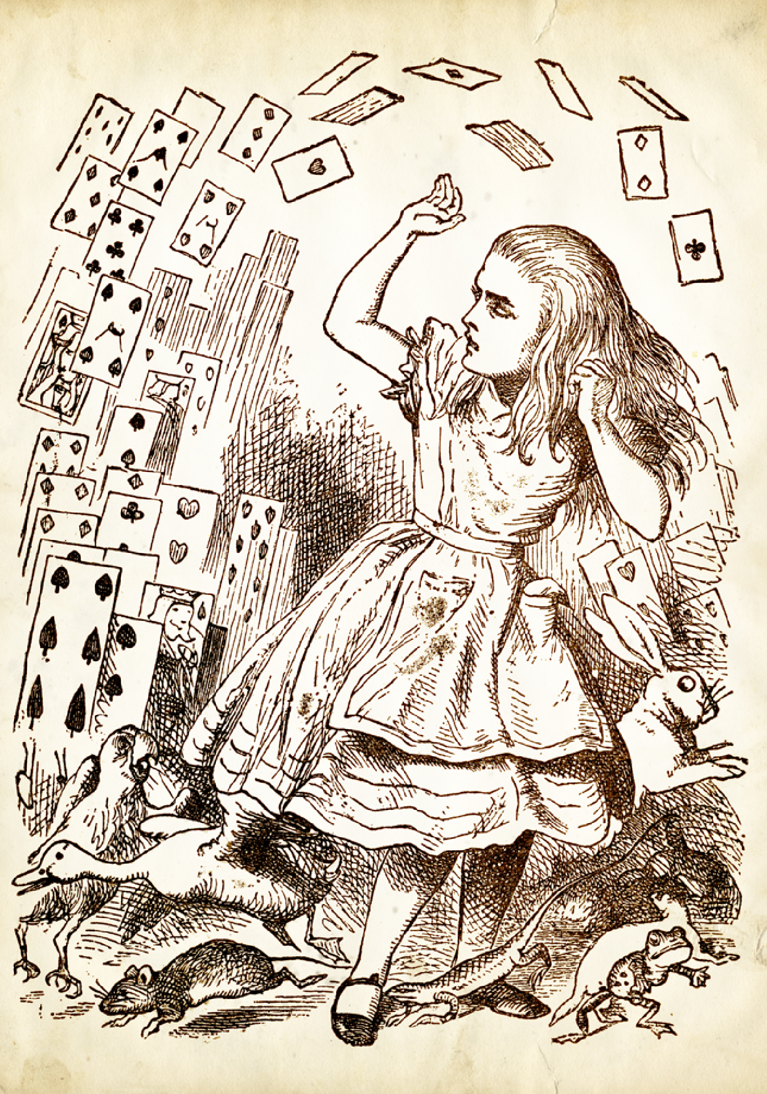

Slide 11
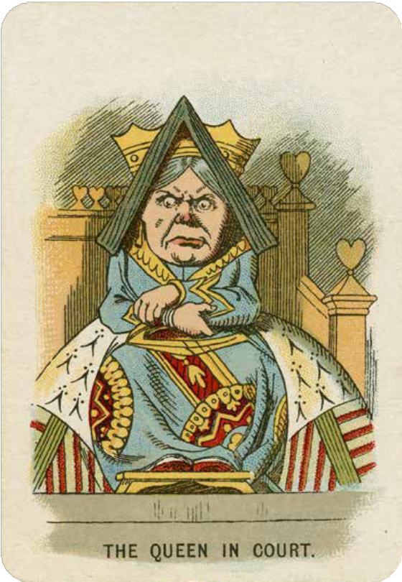
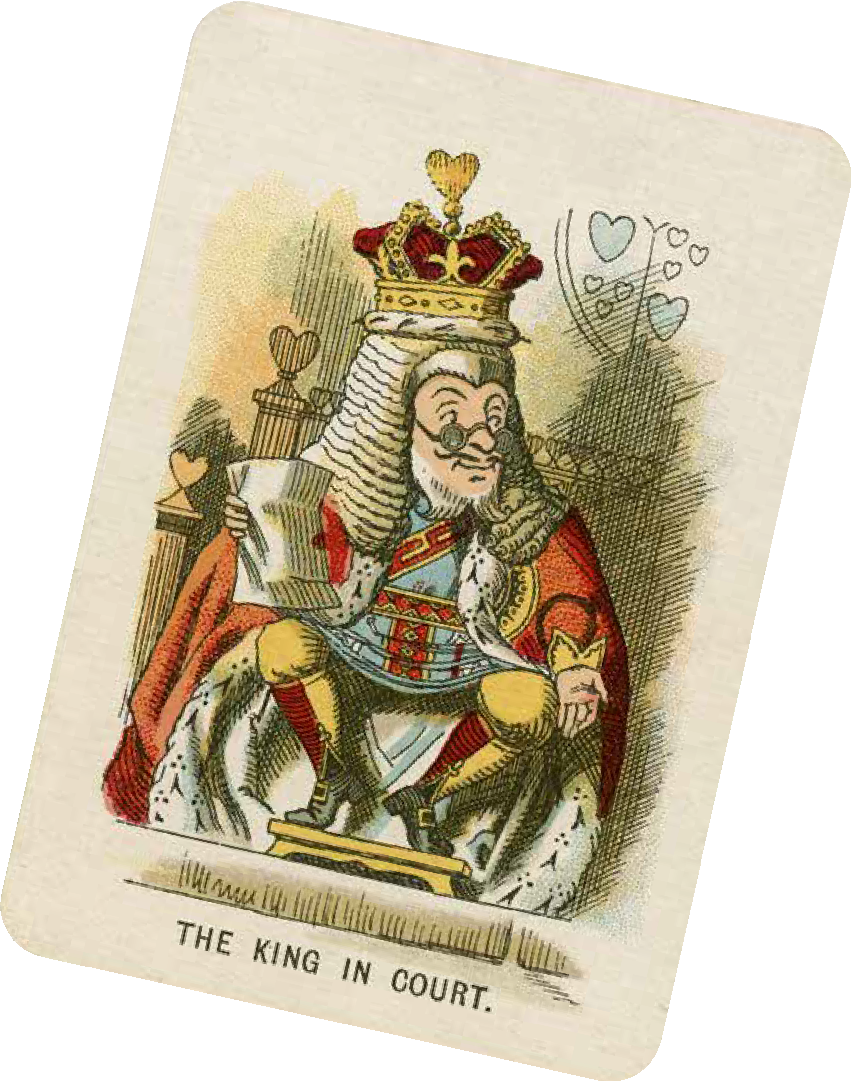
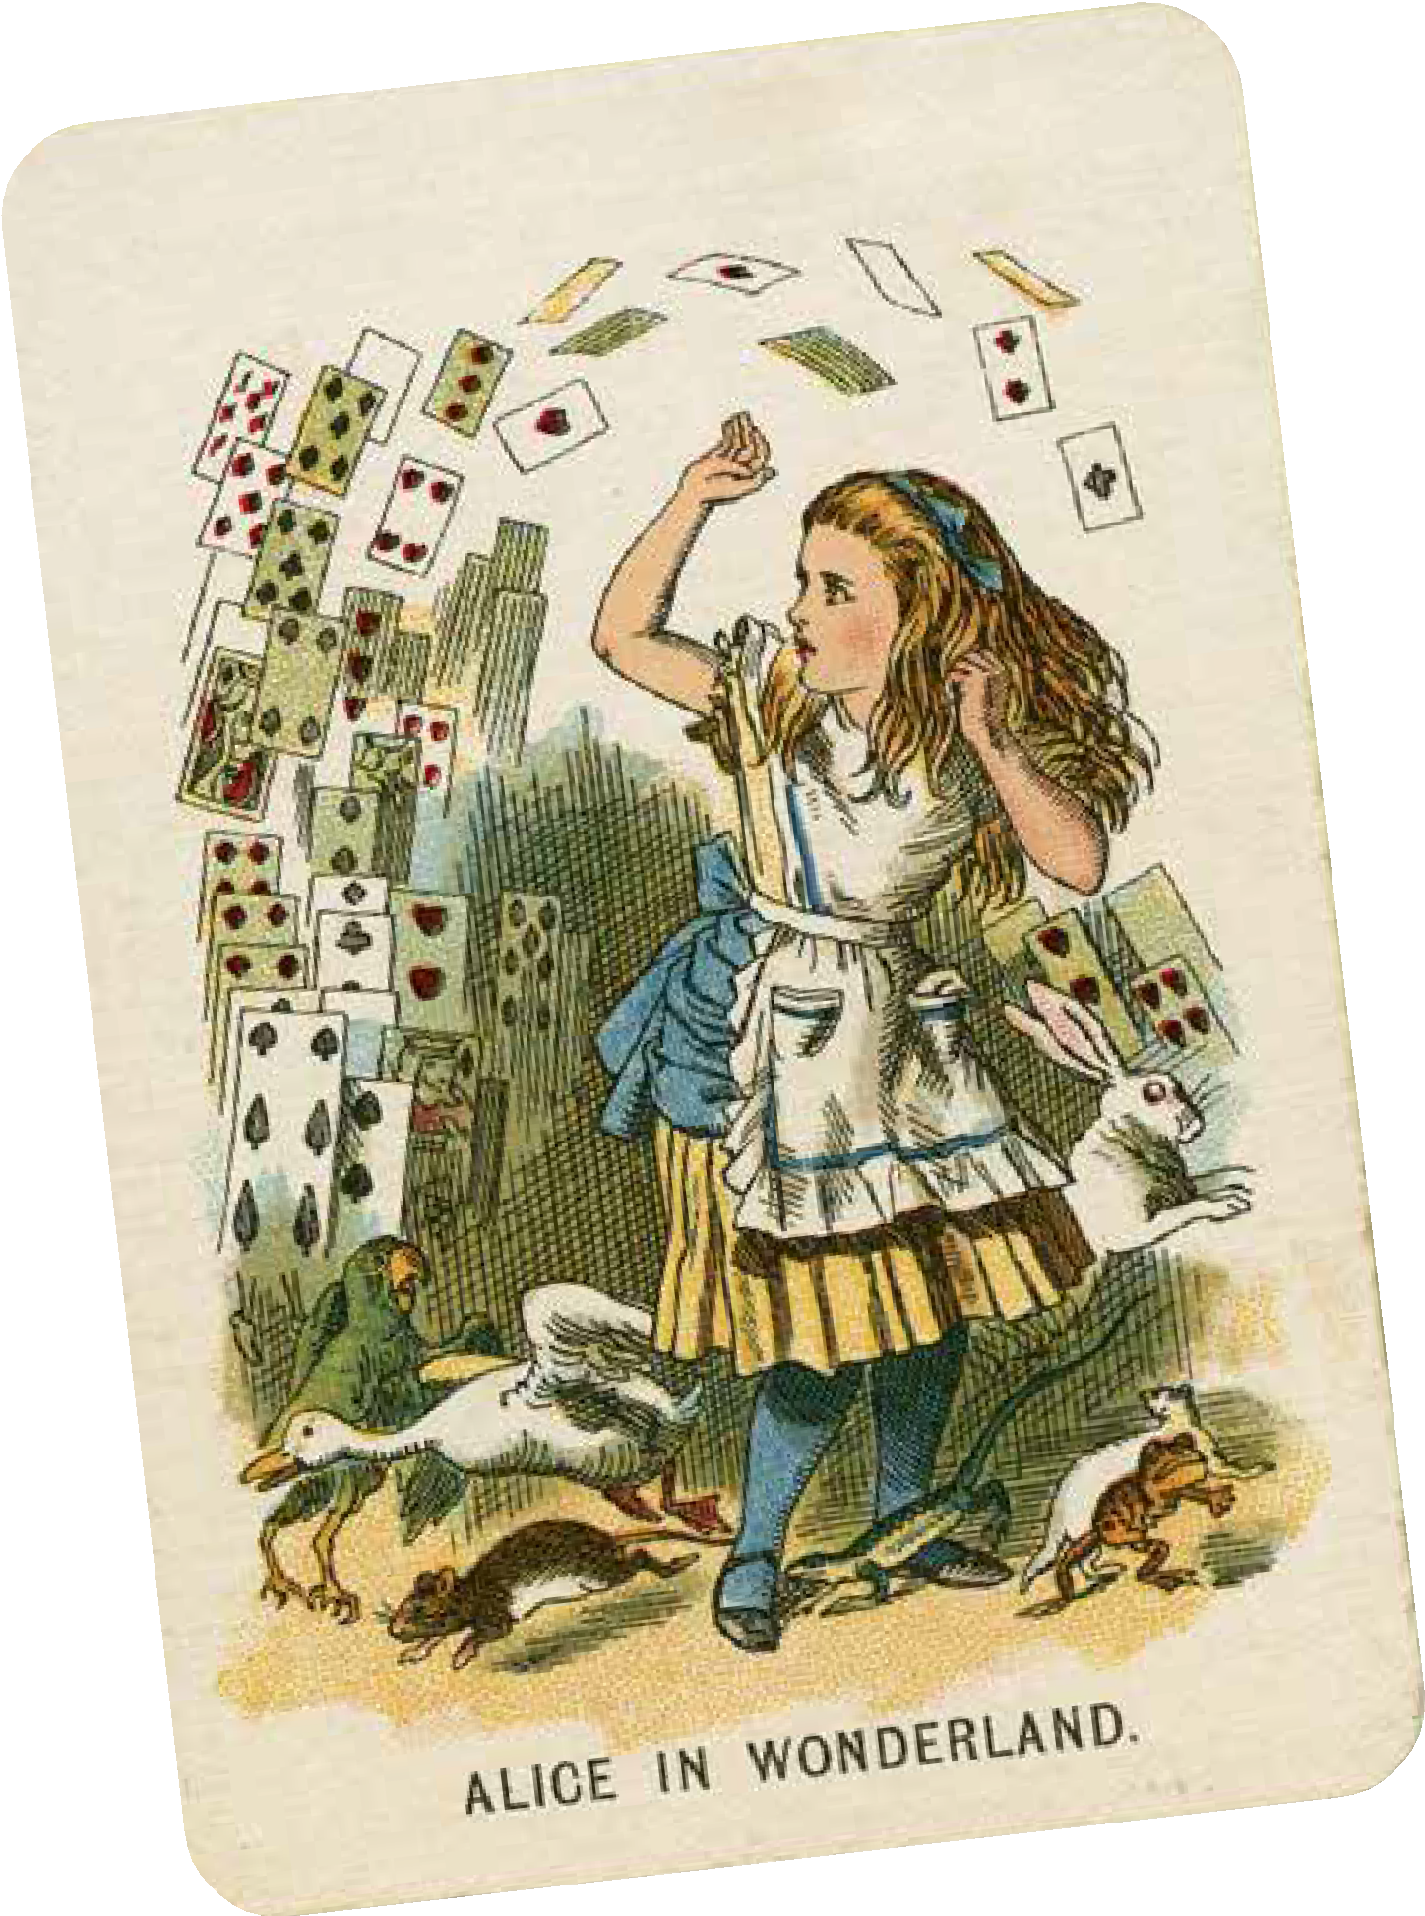
Alice in Wonderland
Whilst we read,
Consider the emotions of the Queen of Hearts, the King of Hearts and Alice.
Jot down your ideas in the margin of your text as we go.

Slide 12
