Slide 1

Bridging Project — Lesson 8

Slide 2

Freeze frames
I will read out some scenarios.
After each one, create a freeze frame to illustrate that specific situation.
Notes:
See Lesson Plan for scenarios.

Slide 3
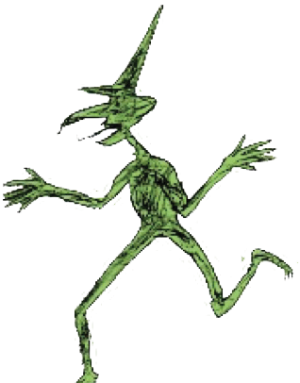
Hikey Sprites
Consider how your Hikey Sprite will be introduced to your main character.
The reveal should match to the personality or characteristics you have chosen for your Hikey Sprite. If they are a good sprite, how will they appear? If they are mischievous how would their appearance differ?

Slide 4
Putting pen to paper, continued…
Today, you are continuing your work, thinking about the ‘build-up’ of the story.
Your main character will come to meet the Hikey Sprite you created!
Let’s complete some shared writing again, before you add to your own work.

