Slide 1
Bridging Project — Lesson 7

Slide 2
The Hikey Sprites
Light drained away quickly as Tom raced home. Night was creeping in all about him, and the breeze made the limbs of trees clash together with ugly thuds and cracks. He needed to hurry, or he would be in big trouble with Gran. She had told him to be home before nightfall.
Every summer, his parents would go away, and he would spend a week with Gran in the Norfolk countryside. He hated it. The only fun he got were the sunny days with
his friends in the fields- making swings, or paddling in streams. Gran had only one rule. Be home before dark.
Tom now raced down the country lane, but he knew the winding country roads would not get him back until long after sundown. Then he saw it. A gap in the hedge,
with a dirt track leading into a dark tunnel of trees. He thought for a moment. Deep shadows held a grip on the path beyond the hedge. A cold chill filled Tom, but it would save him Gran’s punishment. He didn’t know what he would do if she stopped him from seeing his friends.
Walking quickly, Tom plunged into the gloom. He didn’t run, for fear of tripping on a root, or log. Everything was very still in that dark place. Despite it being the height of summer, Tom felt cold, and goose bumps rippled across his arms. He hurried, and with each step, it seemed that the blanket of darkness became thicker and thicker, as though night had completely fallen in the few moments since he entered the wood.

Slide 3
He saw the first figure then. Ahead, in the gloom, and between the tangle of branches. No, wait- not among the branches- on top of them. It was thin, shadowy, no longer than his forearm and beckoned him on with arms and fingers that were too long, too thin and too cruel
to be human. Tom hesitated, and made to run, but he turned to find himself confronted with a contorted tangle of leaves and branches, which clawed at him from
the dark.
His foot caught on a root, and plummeted to the earth, with a shock of pain he crashed into the dead twigs and branches on the ground. He rolled, and could see the movements of many hundreds of tiny figures about him in the dark.
Pulling himself from the ground, Tom stumbled on, and burst onto the road like a rocket. He did not stop running until he could see Gran’s house. A Police car was parked outside, and a Police officer was talking to the stooped form of Tom’s gran. Both looked startled as the boy appeared, and threw his arms around Gran. His voice muffled by her cardigan, Tom asked why the Police officer was there.
Gibbering and cackling filled the air. From the corner of his eye, Tom saw more of the thin figures spinning, tumbling and cartwheeling down the branches like acrobats in the circus. Leering faces grinned from the gloom, while grasping hands snatched from the
branches at Tom’s hair. He flailed his arms; he knocked aside leaves and small creatures, but that only seemed to make them laugh harder. With his feet pounding over the dried leaves and dirt, he raced towards the gap
in the hedge, or what he thought was the gap in the hedge. Behind him, the laughter pursued.
“Why, you’ve been gone three days,” Gran replied, “I told you to be home before dark.”
https://drive.google.com/file/d/1iA7BNOVjGXdqP02517mCWyXgAxpSol-j/view

Slide 4
Review
Have a read through of your planning from our last session, remind yourself of your story line and plot.
Then, in pairs, re-tell your narrative; you could think about using voices or props to present.
The more familiar you are with your narrative, the smoother the writing process should be!

Slide 5
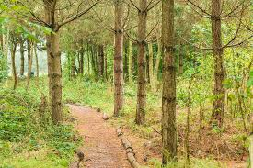
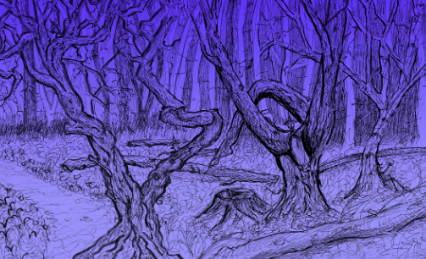
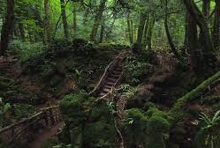
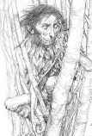
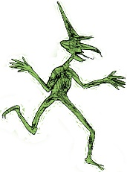
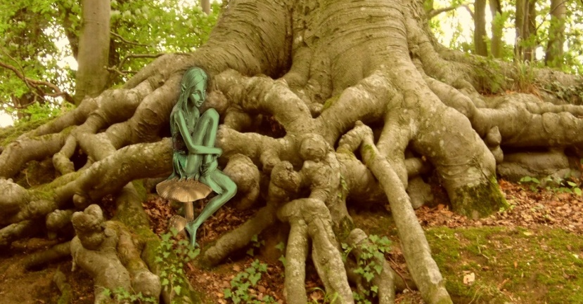
Today, we are going to be thinking about our settings and characters in more depth. By the end of this lesson, we will have a fully planned story, ready to begin writing tomorrow.

Slide 6
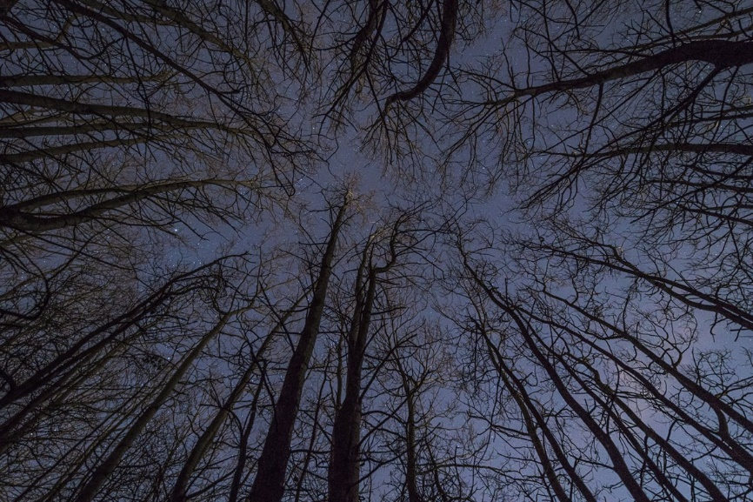
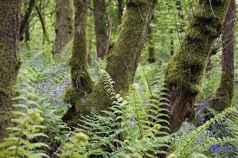
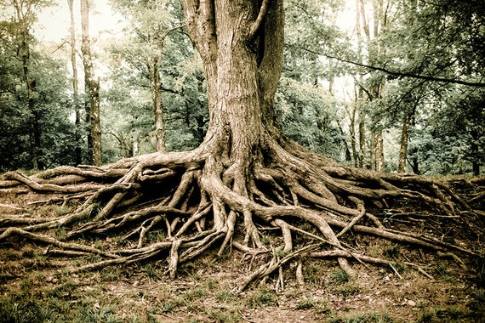
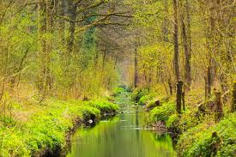
Settings

Slide 7
Discussion
What makes a good description for a setting?
Look back at your knowledge organiser – there are ideas on here which will be useful in helping you create effective descriptions for your woodland setting.

Slide 8
Character: Hikey Sprite

Slide 9
Discussion
What makes a good description for a character?
Look back at your knowledge organiser and the drawing you created – there are ideas on here which will be useful in helping you create effective descriptions for your Hikey Sprite.

