Slide 1
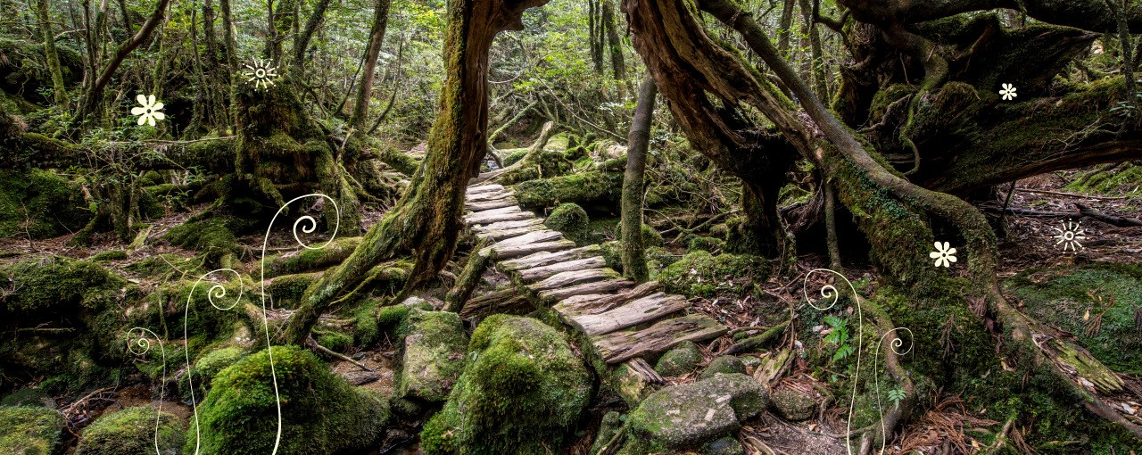
Bridging Project — Lesson 2

Slide 2

Natural Findings
Share the things you gathered with the people around you.
Explain where you found them - be specific:
“I found them at the bottom of the garden, where nobody goes, and they were under a tree.”

Slide 3
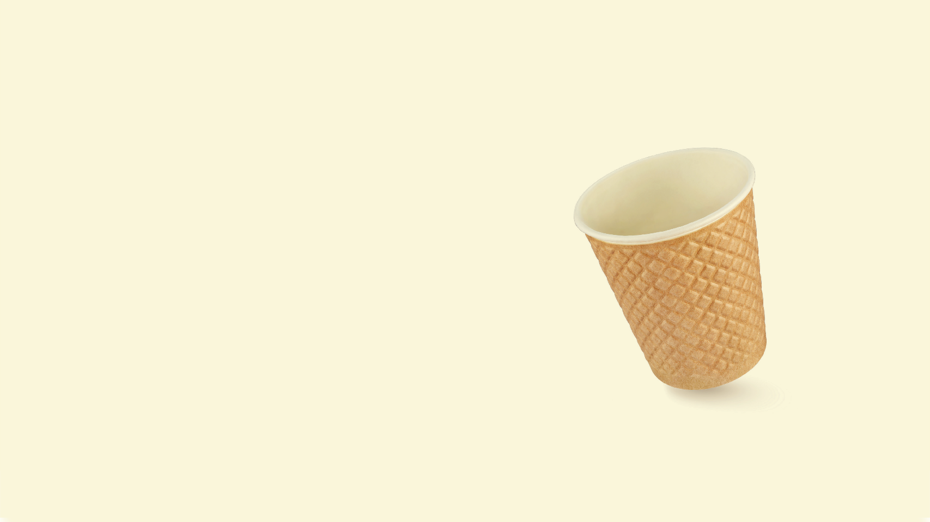
Gathering Words
Now, mix your items into the cups provided.
Pass them around and smell them. Can you describe the smell?
Here are some words to help:
Why you choose one word, and not another…?
Acrid - Musty - Musky - Decayed - Smoky - Pungent - Putrid - Earthy Dusty - Damp - Spoiled - Rancid - Sharp - Rotten - Stale - Fragrant - Sweet

Slide 4
Using all your senses
There are 5 pieces of paper around the room. One for each of your senses.
Using our sensory cups, and experience, add rich vocabulary to these sheets.
Aim to include rich and ambitious vocabulary.
We will then take these ideas and begin writing small descriptive passages.

