Slide 1
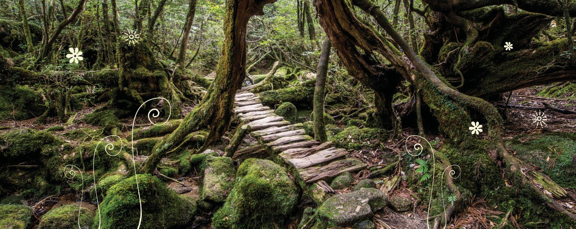
Bridging Project — Lesson 1

Slide 2
Imaginarium
Form a circle, step in when invited.
Form the shape of something you would expect to find in woodlands.
Describe the item, for example: ‘a moss-covered rock’ or ‘starving wolves’.
When it’s your turn – can you build to or add to another person’s creation?

Slide 3
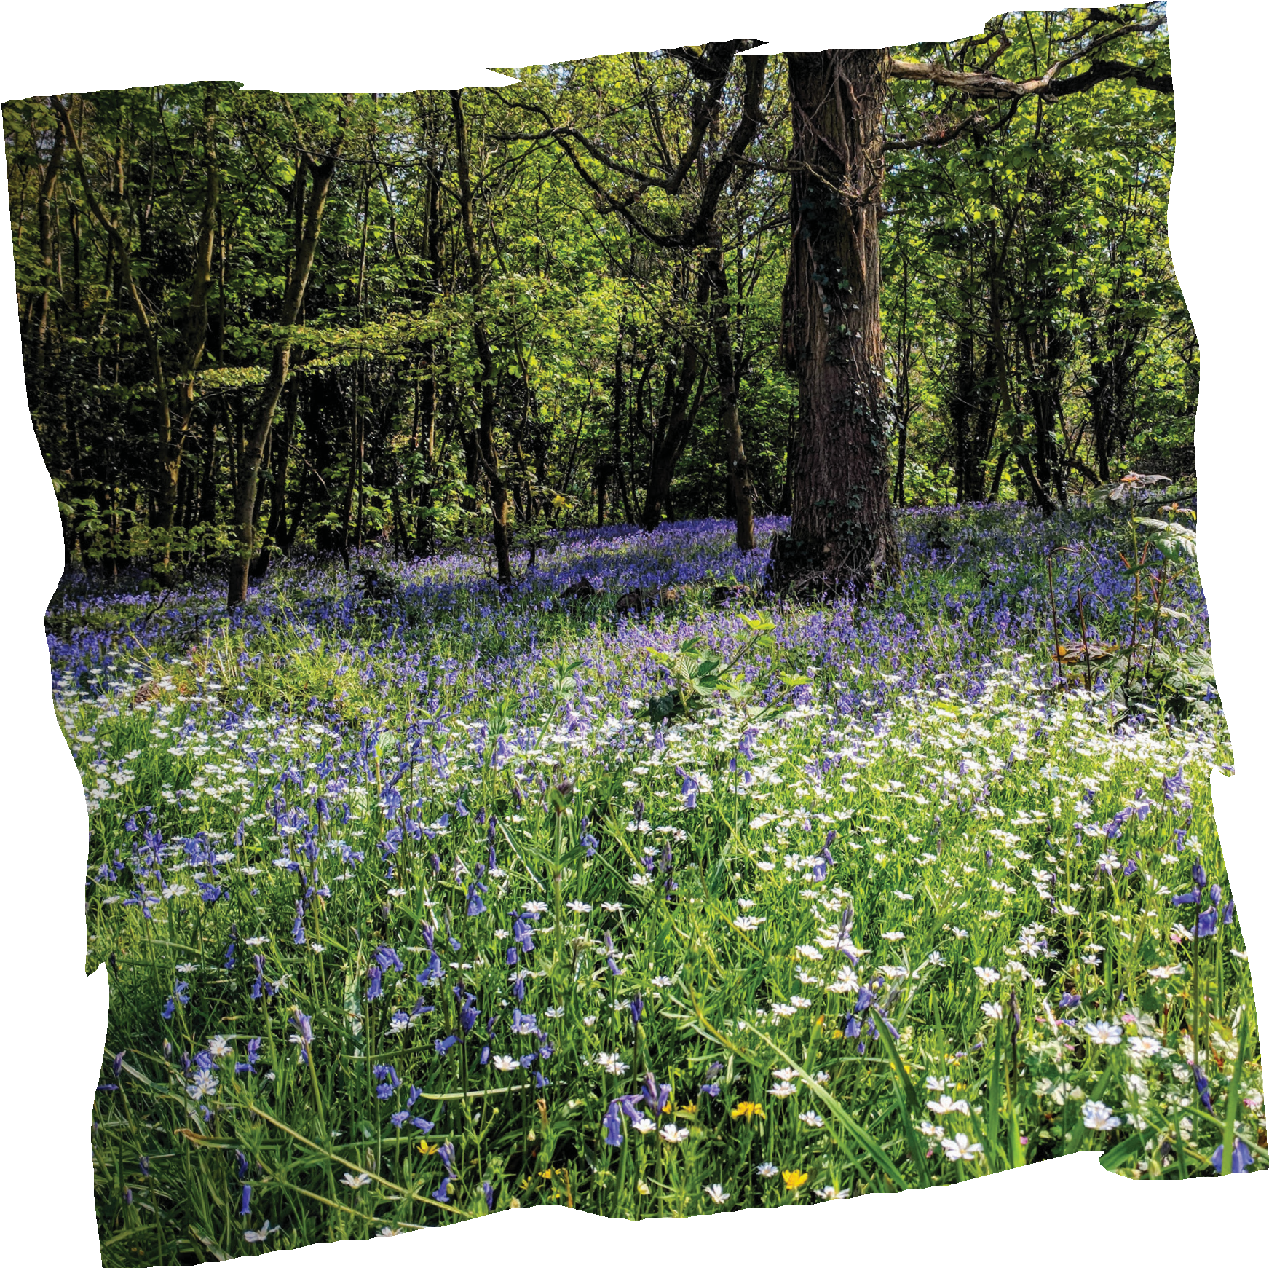
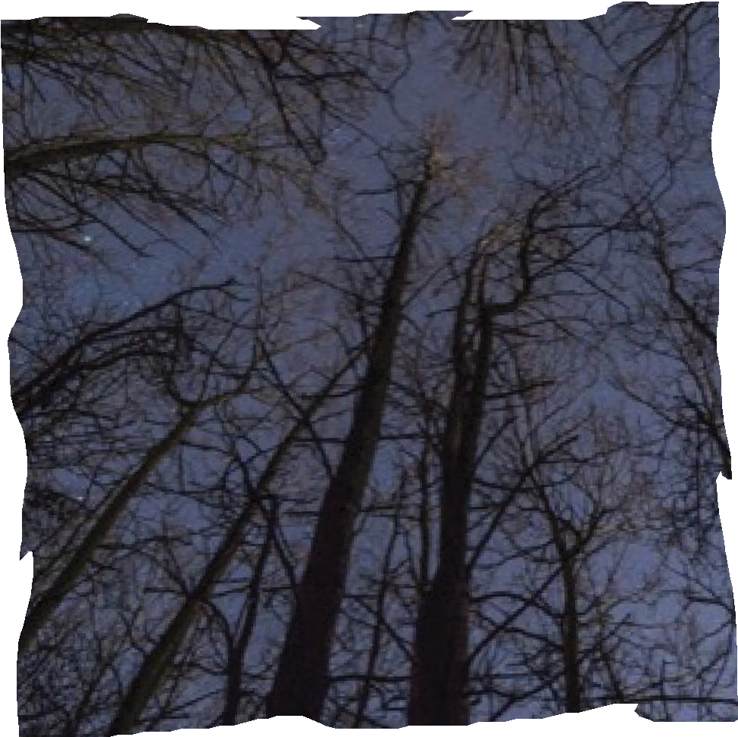
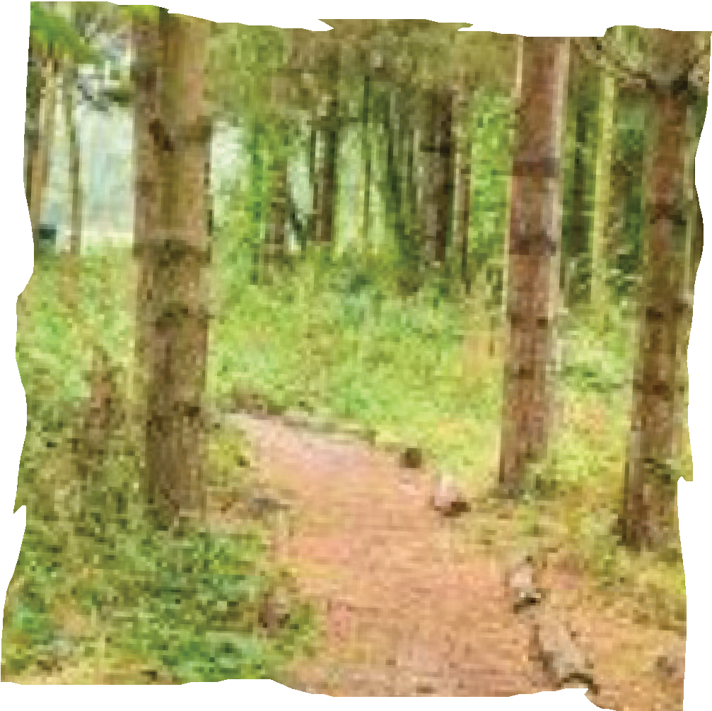
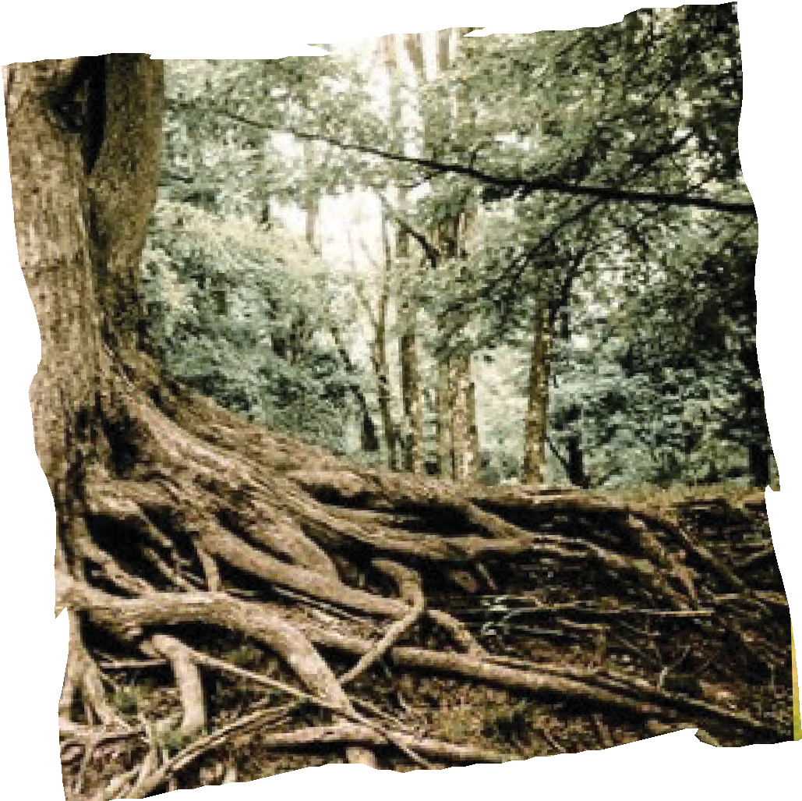
Woodlands

Slide 4
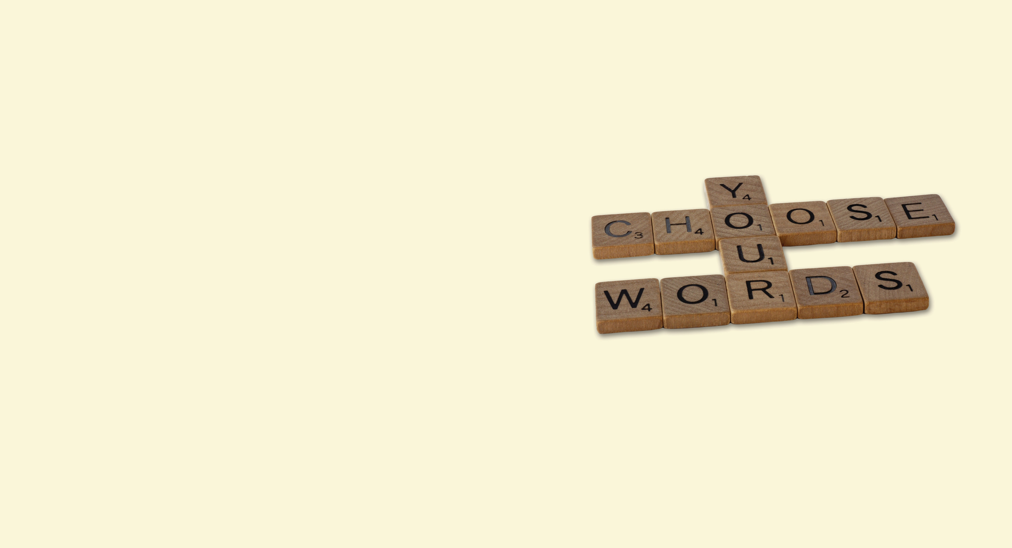
Woodlands
Read the text (we will finish the story later!)
Highlight your favourite words/phrases from the text – discuss.
Arrange these words/phrases in any order you choose – alphabetical, length, favourite to least favourite etc.
Build sentences using the arranged order of these words/phrases, creating a short passage of writing.

Slide 5
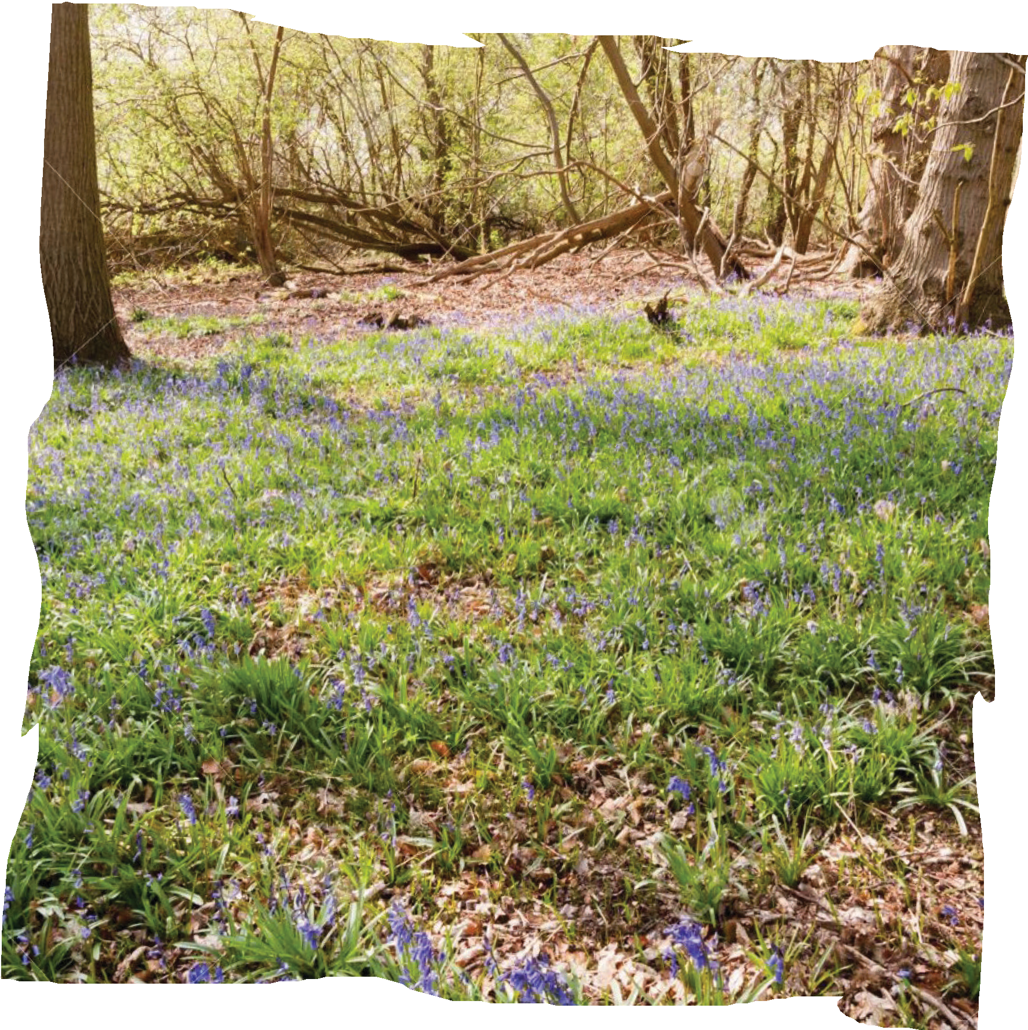
Thinking ahead…
Ready for next lesson:
Gather flowers, leaves, small sticks etc. to bring in for us to use.

